Slide 1

CT4005: Games Production
Lecture 04 – Player Experience
(Sign in now) Password - gt7p3c
John Moss, Dr Will Sayers, University of Gloucestershire

Slide 2
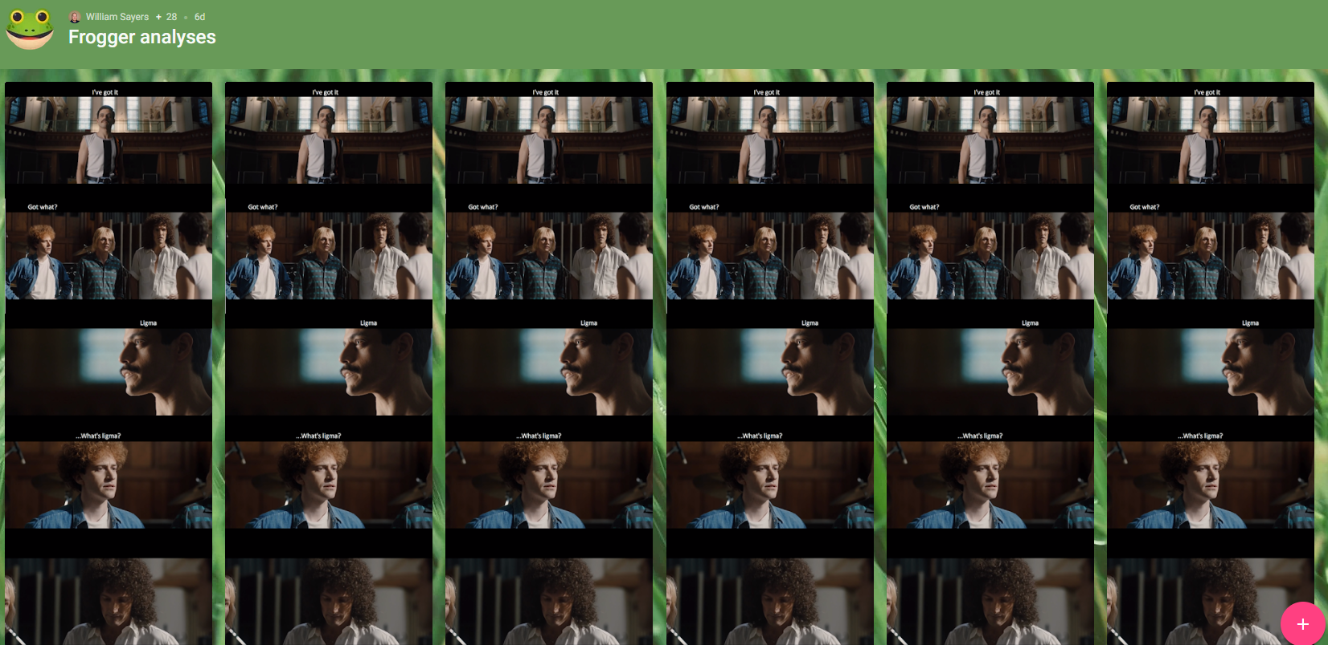
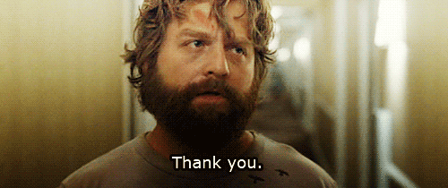

Slide 3
Overview
Player Experience
The role of a designer
Gamification / Rewards
Psychology the factors
Flow
Conditioned Pleasure
Punishment
Decisions
Repetition
Reflection
Engagement and Motivation

Slide 4
Player Experience
Players experience – Player experience constitutes one of the most significant factors in determining the success rate of games. Games which do not provide enormous user experience usually will not gain intense interest from players. The concept of player experience is normally interchanged with concepts such as fun, flow, fulfillment, enjoyment, engagement, satisfaction, pleasure and playability.
The sooner you can bring the player into the equation the better, and the first way to do this is to set “player experience goals”

Slide 5
The game is not the experience
The game enables the experience, but it is not the experience.
The ancient Zen question addresses this directly:
“If a tree falls in the forest, and no one is there to hear it, does it make a sound? ”
If our definition of “ sound ” is air molecules vibrating, then yes, the tree makes a sound.
If our definition of sound is the experience of hearing a sound, then the answer is no, the tree makes no sound when no one is there.
As designers, we don’t really care about the tree and how it falls — we care only about the experience of hearing it. The tree is just a means to an end. And if no one is there to hear it, well, we don’t care at all.
The game is not the experience. The game enables the experience.
Notes:
The Game Is Not the Experience
We must be absolutely clear on this point before we can proceed. The game is not the experience. The game enables the experience, but it is not the experience. This is a hard concept for some people to grasp. The ancient Zen question addresses this directly: “If a tree falls in the forest, and no one is there to hear it, does it make a sound?” This has been repeated so often that it sounds hackneyed, but it is exactly what we are talking about. If our definition of “sound” is air molecules vibrating, then yes, the tree makes a sound. If our definition of sound is the experience of hearing a sound, then the answer is no, the tree makes no sound when no one is there. As designers, we don’t really care about the tree and how it falls — we care only about the experience of hearing it. The tree is just a means to an end. And if no one is there to hear it, well, we don’t care at all.
Game designers only care about what seems to exist. The player and the game are real. The experience is imaginary — but game designers are judged by the qual- ity of this imaginary thing because it is the reason people play games.
If we could, through some high-tech magic, create experiences for people directly, with no underlying media — no game boards, no computers, no screens — we would do it. In a sense, this is the dream of “artificial reality” — to be able to create experiences that are in no way limited by the constraints of the medium that delivers the experiences. It is a beautiful dream, but only a dream. We cannot create expe- riences directly. Perhaps in the distant future, using technologies hard to imagine, such a thing could happen. Time will tell. For now, we live in the present, where all we can do is create artifacts (rule sets, game boards, computer programs) that are likely to create certain kinds of experiences when a player interacts with them.
And it is this that makes game design so very hard. Like building a ship in a bot- tle, we are far removed from what we are actually trying to create. We create an arti- fact that a player interacts with, and cross our fingers that the experience that takes place during that interaction is something they will enjoy. We never truly see the output of our work, since it is an experience had by someone else and, ultimately, unsharable.
This is why deep listening is so essential for a game design.

Slide 6
Aesthetics / mda / 6-11 Format
There are eight type of Aesthetics as stated by Hunicke, LeBlanc and Zubek:
Sensation (Game as sense-pleasure): Player experiences something completely unfamiliar.
Fantasy (Game as make-believe): Imaginary world.
Narrative (Game as drama): A story that drives the player to keep coming back
Challenge (Game as obstacle course): Urge to master something. Boosts a game's replayability.
Fellowship (Game as social framework): A community where the player is an active part of it. Almost exclusive for multiplayer games.
Discovery (Game as uncharted territory): Urge to explore game world.
Expression (Game as self-discovery): Own creativity. For example, creating character resembling player's own avatar.
Submission (Game as pastime): Connection to the game, as a whole, despite of constraints.
Six Emotions are:
Fear
Anger
Joy /happiness
Pride
Sadness
Excitement
Notes:
remove

Slide 7

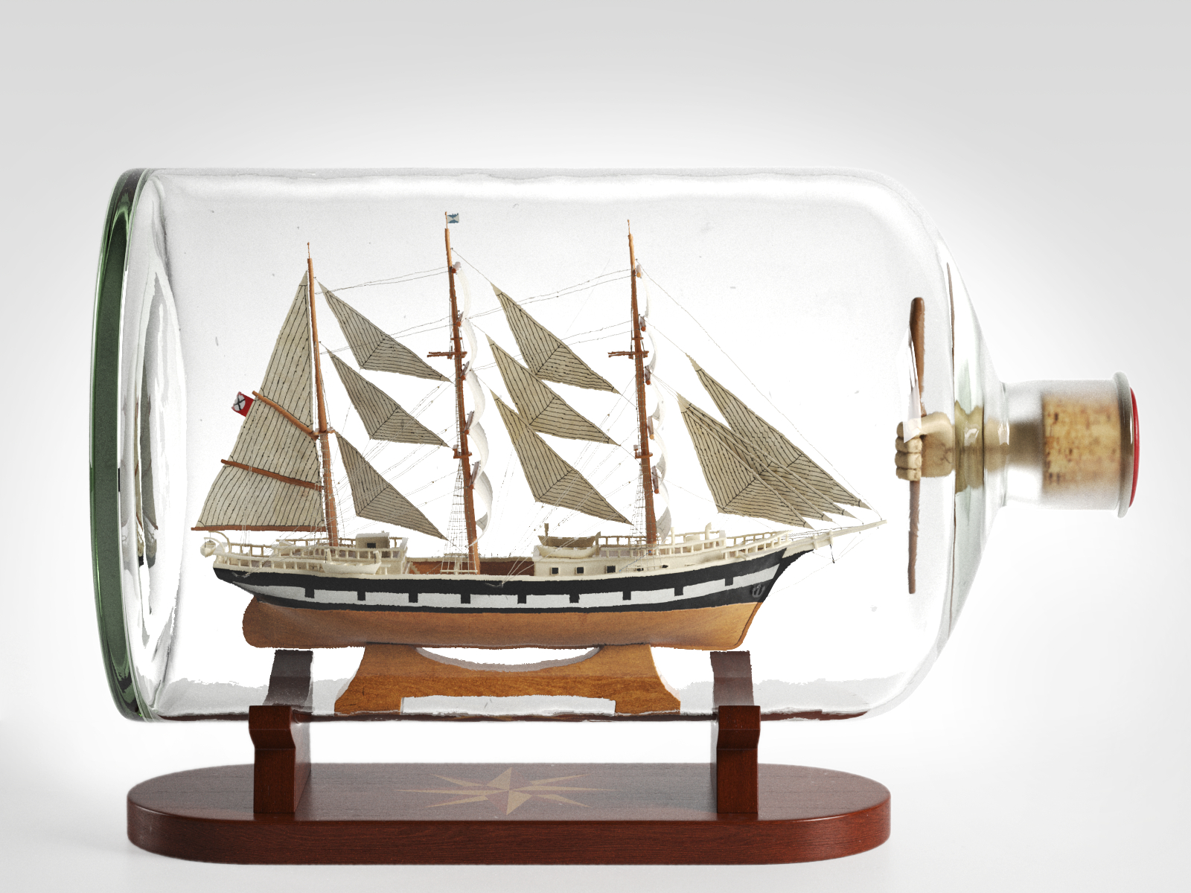
Making that experience
Game designers only care about what seems to exist. The player and the game are real. The experience is imaginary but game designers are judged by the quality of this imaginary thing because it is the reason people play games.
In a sense, this is the dream of “artificial reality ” — to be able to create experiences that are in no way limited by the constraints of the medium that delivers the experiences. It is a beautiful dream, but only a dream.
We create an artefact that a player interacts with, and cross our fingers that the experience that takes place during that interaction is something they will enjoy.
This is why deep listening is so essential for a game design.
We cannot create experiences directly
Notes:
We cannot create experiences directly. Perhaps in the distant future, using technologies hard to imagine,
such a thing could happen. Time will tell. For now, we live in the present, where all we can do is create artifacts (rule sets, game boards, computer programs) that are likely to create certain kinds of experiences when a player interacts with them. And it is this that makes game design so very hard. Like building a ship in a bottle, we are far removed from what we are actually trying to create. We create an artefact that a player interacts with, and cross our fingers that the experience that takes place during that interaction is something they will enjoy. We never truly see the
output of our work, since it is an experience had by someone else and, ultimately, unsharable.
This is why deep listening is so essential for a game design.

Slide 8

Is This Unique to Games?
Designers of all types of entertainment — books, movies, plays, music, rides, everything — have to cope with the same issue: How can you create something that will generate a certain experience when a person interacts with it?
Game designers don’t have it so easy. We give the player a great deal of control over the pacing and sequence of events in the experience.
Notes:
You might well ask what is so special about games, compared to other types of
experiences, that requires us to get into all of this touchy-feely experience stuff. And
really, on one level, there is nothing special about games in this regard. Designers of
all types of entertainment — books, movies, plays, music, rides, everything — have
to cope with the same issue: How can you create something that will generate a certain
experience when a person interacts with it?
But the split between artifact and experience is much more obvious for game
design than it is for other types of entertainment, for a not-so-obvious reason. Game
designers have to cope with much more interaction than the designers of more linear
experiences. The author of a book or screenplay is designing a linear experience.
There is a fairly direct mapping between what they create and what the reader or
viewer experiences. Game designers don’t have it so easy. We give the player
a great deal of control over the pacing and sequence of events in the experience.

Slide 9
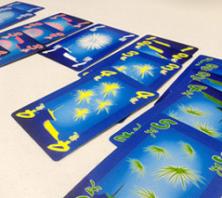
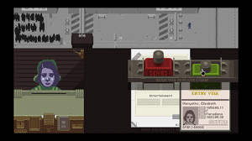
Experience
It builds the kind of social connection that normally only develops after years of associating with a group of peers. The cards and what you do with them are only the avenue that this experience is built upon.
Theme is just context for the core aesthetics of a game.
In Hanabi, the primary experience is not about collecting cards in numeric order.
Empathy game
Player take the role of a border crossing immigration officer in the fictional dystopian Eastern Bloc-like country of Arstotzka
empathy game
Notes:
It would be a mistake to try to define something like Hanabi by its mechanics. Players are trying to lay out cards of various colors in order from 1 to 5, but that is not what the game is about. The experience of the game is about learning to communicate layers of information through subtle use of position, timing, and other shared conventions. It builds the kind of social connection that normally only develops after years of associating with a group of peers. The cards and what you do with them are only the avenue that this experience is built upon.
So you go into the theme: maybe you are a team of firefighters saving people from a burning building. But, even describing what you do in a game in thematic terms is not quite the same as defining the experience of playing it. Video games tend to be more thematic than board games, but the same thing applies to them. The game Papers, Please is not about checking passports at a border crossing. It’s about maintaining both your family and your humanity in a situation that frequently asks you to sacrifice one to save the other. In the broader sense, theme is just context for the core aesthetics of a game.
https://www.youtube.com/watch?v=d_js_3S_7K8
Thematic
having or relating to subjects or a particular subject.

Slide 10
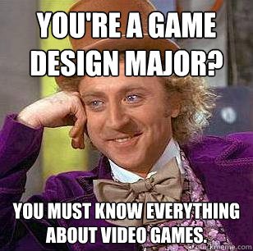
The role of the game designer
How does the designer do this?
In some ways, designing a game is like being the host of a party.
Must be an advocate for the player. The games designer must look at the world of games through the eyes of the player.
You’d be surprised how often this concept is ignored.
Notes:
In some ways, designing a game is like being the host of a party. As the host, it’s your job to get everything ready—food, drinks, decorations, music to set the mood—and then you open the doors to your guests and see what happens. The results are not always predictable or what you envisioned. A game, like a party, is an interactive experience that is only fully realized a er your guests arrive. What type of party will your game be like? Will your players sit like wallflowers in your living room? Will they stumble around trying to fi nd the coatroom closet? Or will they laugh and talk and meet new people, hoping the night will never end? Inviting players “over to play” and listening to what they say as they experience your game is the best way to understand how your game is working. Gauging reactions, interpreting silent moments, studying feedback, and matching those with specific game elements are the keys to becoming a professional designer. When you learn to listen to your players, you can help your game to grow.

Slide 11
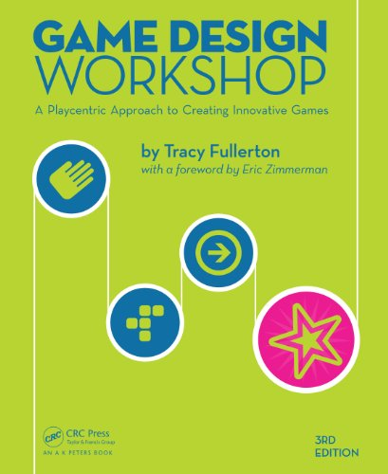
Where's this going -Play centric games design
When designing a game we need frequent feedback
From others in the team
From play testers: independent views
A play centric approach involves the player in the games design process from conception to completion
Continually keep the player experience in mind
Test the game with target audience through every phase of development
More on this next year…..

Slide 12

Inspiration
A game designer often looks at the world differently from most people. This is in part because of the profession and in part because the art of game design requires someone who is able to see and analyse the underlying relationships and rules of complex systems and to find inspiration for play in common.
Games are Everywhere.
Look at the world in terms of it underlaying systems.
Don’t just look at existing games.
Look at world the world around you.
Notes:
Why not look at other games for inspiration? Well, of course, you can and you should. We’ll talk about that in just a minute. But if you want to come up with truly original ideas, then don’t fall back on existing games for all your ideas. Instead, look at the world around you. Some of the things that have inspired other game designers and could inspire you are obvious: personal relationships, buying and selling, competition
in the workplace, etc. Take ant colonies, for example. They’re organized around a sophisticated set of rules, and there’s competition both within the colonies and between competing insect groups.
Well-known game designer Will Wright made a game about ant colonies in 1991, SimAnt. “I was always fascinated by social insects,” he says. “Ants are one of the few real examples of intelligence we have that we can study and deconstruct. We’re still struggling with the way the human brain works. But if you look at ant colonies, they sometimes exhibit a remarkable degree of intelligence.”1 The game itself was something of disappointment commercially, but the innate curiosity about how the world works that led Wright to ant colonies has also led him to look at ecological systems such as the Gaia hypothesis as inspiration for Sim Earth or psychological theories such as Maslow’s hierarchy of needs as inspiration for artificial intelligence in The Sims. Having a strong sense of curiosity and a passion for learning about the world is clearly an important part of Wright’s inspiration as a game designer.
Maslow's hierarchy of needs is a theory in psychology proposed by Abraham Maslow in his 1943 paper "A Theory of Human Motivation" in Psychological Review. Maslow subsequently extended the idea to include his observations of humans' innate curiosity.

Slide 13
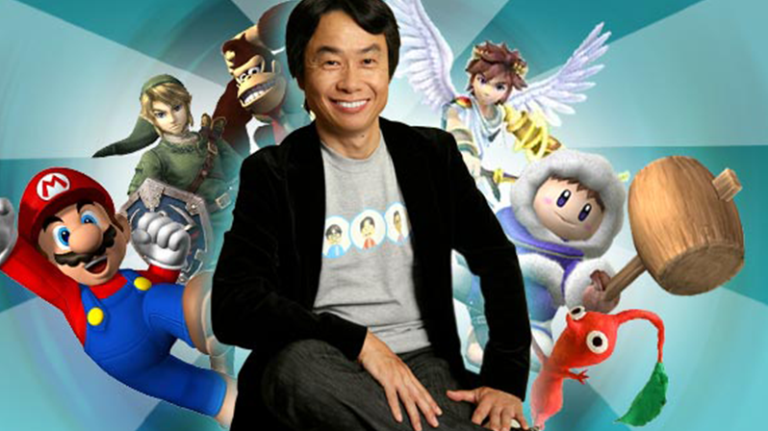
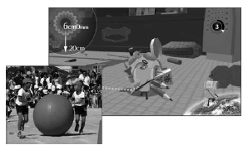
Creativity - What inspires you?
Nintendo’s Shigeru Miyamoto
Many of Miyamoto’s games draw from this sense of exploration and wonder that he remembers from childhood
Keita Takahashi, Katamari
tamakorogashi (ballroller)
Everyone has a different style for coming up with ideas and being creative. What matters is not the spark of an idea but what you do with that idea once it emerges, and this is where the playcentric process becomes critical.
Task# List five games you played as a child; for example, hide and seek, four square, tag, etc. Briefly describe what was compelling about each of those games.
Notes:
Think about your own life experiences. Do you have memories that might spark the idea for a game? One reason that childhood can be such a powerful inspiration for game designers is that when we are children, we are particularly engrossed in playing games. If you watch how kids interact on a playground, it’s usually through game playing. They make games and learn social order and group dynamics from their play. Games permeate all aspects of kids’ lives and are a vital part of their developmental process. So if you go back to your childhood and look at things that you enjoyed, you’ll find the raw material for games right there.
Exercise 1.5: Your Childhood List ten games you played as a child; for example, hide and seek, four square, tag, etc. Briefly describe what was compelling about each of those games.
Our past experiences, our other interests, our relationships, and our identity all come into play when trying to reach our creativity. Great game designers find a way to tap into their creative souls and bring forth the best parts in their games. However you do it, whether you work alone or in a team, whether you read books or climb mountains, whether you look to other games for inspiration or to life experiences, the
bottom line is that there’s no single right way to go about it. Everyone has a different style for coming up with ideas and being creative. What matters is not the spark of an idea but what you do with that idea once it emerges, and this is where the playcentric process becomes critical.

Slide 14

The role of the goal
When it comes to understanding the pleasure of a game, the goal plays an absolutely crucial role.
A game's goal is often the largest single element that drives the pleasure of a player.
Carrot just out of reach, pulling players forward through the varied pleasures of game play.
Descriptions of situations in which players find themselves
Broad aims & objectives of the game
Not feature driven – that comes later
Consider what the target audience thinks/feels
As they make choices in the game
Are the choices rich & interesting enough?

Slide 15
Player Experience Goals
These are not features of the game but rather descriptions of the interesting and unique situations in which you hope players will find themselves.
“players will have to cooperate to win, but the game will be structured so they can never trust each other,”
“players will feel a sense of happiness and playfulness rather than competitiveness,”
“players will have the freedom to pursue the goals of the game in any order they choose.”
Notes:
Look a this…………….
The sooner you can bring the player into the equation, the better, and the first way to do this is to set “player experience goals.” Player experience goals are just what they sound like: goals that the game designer sets for the type of experience that players will have during the game. These are not features of the game but rather descriptions of the interesting and unique situations in which you hope players will find themselves. For example, “players will have to cooperate to win, but the game will be structured so they can never trust each other,” “players will feel a sense of happiness and playfulness rather than competitiveness,” or “players will have the freedom to pursue the goals of the game in any order they choose.”

Slide 16
Player Experience Goals
Common goals
Example non-computer game
Capture/destroy
Territorial control
Collection
Solve
Chase/race/escape
Spatial alignment
Build
Negation of another goal
Chess
Risk
Card games
Cluedo
Tag
Noughts & crosses
Lego
Jenga
Notes:
Capture/destroy. Eliminate all of your opponent’s pieces from the game. Chess and Stratego are some well-known examples where you must eliminate the opposing forces to win.
Territorial control. The focus is not necessarily on destroying the opponent, but on controlling certain areas of the board. RISK andDiplomacy are examples.
Collection. The card game Rummy and its variants involve collecting sets of cards to win. Bohnanza involves collecting sets of beans. Many platformer video games (such as the Spyro series) included levels where you had to collect a certain number of objects scattered throughout the level.
Solve. The board game Clue (or Cluedo, depending on where you live) is an example of a game where the objective is to solve a puzzle. Lesser-known (but more interesting) examples are Castle of Magic and Sleuth.
Chase/race/escape. Generally, anything where you are running towards or away from something; the playground game Tag and the video gameSuper Mario Bros. are examples.
Spatial alignment. A number of games involve positioning of elements as an objective, including the non-digital games Tic-Tac-Toe and Pente and the video game Tetris.
Build. The opposite of “destroy” — your goal is to advance your character(s) or build your resources to a certain point. The Sims has strong elements of this; the board game Settlers of Catan is an example also.
Negation of another goal. Some games end when one player performs an act that is forbiden by the rules, and that player loses. Examples are the physical dexterity games Twister and Jenga.

Slide 17
Example Player Experience Goals
Players work as team in order to complete tasks, overcome obstacles and finish the game
Players have the freedom to set their own goals and tasks, and pursue these goals in any order and at any pace they choose
Players will become emotionally attached to their characters
Players will go through a range of emotions throughout the course of the game
Consider when playing a game
Some players become bored and switch off
Some players become frustrated and switch off
Why does this happen?
Notes:
High level goals

Slide 18
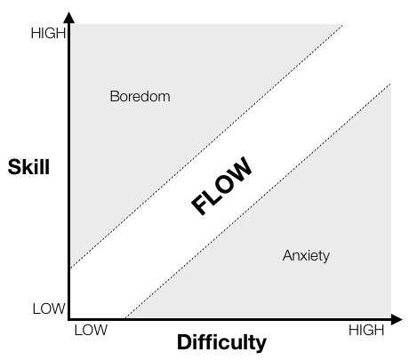
gAMEFlow
With players, skill & difficulty interact to produce different emotional states
What happens in each of these outcomes.
Skill low / difficulty High
Skill High / difficulty Low
Mihaly Csikszentmihalyi (1990)
Notes:
In the 1970s a psychologist named Mihaly Csikszentmihalyi experimentally evaluated Flow. He found that a person's skill and the difficulty of a task interact to result in different cognitive and emotional states. When skill is too low and the task too hard, people become anxious. Alternatively, if the task is too easy and skill too high, people become bored. However, when skill and difficulty are roughly proportional, people enter Flow states (see Figure 1).

Slide 19

Flow states
Using a score system as an example, players may not be able to finish a complete game, but they can try to break their own records, create a sense of accomplishment, or return to complete a full game at a later time. In this example, the reward system makes it easy for players to set goals appropriate for their skill levels. In a game such as Diablo II, which uses an experience point and item reward system, players may not be good enough to defeat the boss, but they can still strengthen their avatars by killing monsters.
While in a flow state people experience:
Extreme focus on a task
A sense of active control
Merging of action and awareness
Loss of self-awareness
Distortion of the experience of time, hours pass
The experience of the task being the only necessary justification for continuing it
Notes:
FLOW AND REWARD
Flow theory, which addresses optimal experiences associated with activities, is currently at the center of research on fun in games. Although it is generally used to analyze intrinsically rewarding experiences, we believe that flow theory is also an appropriate tool for analyzing game systems that distribute extrinsic rewards. Flow experiences have nine characteristics: clear goals at every step, immediate feedback, a balance between challenge and skill, merged action and awareness, a neglect of distractions, no worry of failure, absence of self-consciousness, distorted sense of time, and an autotelic quality. We will focus on three of these in our analysis of how reward systems offer positive experiences: balance between challenge and skill, clear goals, and immediate feedback.
Many video and online gaming researchers have studied the balance between challenges and skills and between boredom and anxiety. Koster (2005) suggests that fun is at the margin of a player’s ability when mentally mastering a problem. When players face challenges that seem too high for their skill levels, their anxiety motivates them to either improve their skills or reduce their challenges; the first option is considered much better because the second generally results in increased frustration. Using a score system as an example, players may not be able to finish a complete game, but they can try to break their own records, create a sense of accomplishment, or return to complete a full game at a later time. In this example, the reward system makes it easy for players to set goals appropriate for their skill levels. In a game such as Diablo II, which uses an experience point and item reward system, players may not be good enough to defeat the boss, but they can still strengthen their avatars by killing monsters. Thus, players feel that they are getting better while the challenge level remains the same—a desirable balance in terms of game design.
When skill levels exceed challenges, players will eventually experience boredom. A reward system can rectify such situations in two ways: modify the emotion through rewards, or help players establish higher challenges. Increasing avatar level (the most common strategy in RPGs) provides fun by making players feel that they are in an active stage of development. However, players may feel bored if the tasks they need to fulfill in order to level up are not sufficiently enjoyable, or fail to trigger a strong sense of anticipation.
Reward systems that provide quick feedback also play an important role in clarifying short-term goals; without them, many games suffer from the problem of having clear long-term but ambiguous short-term goals. Some of the most effective reward systems divide large, complex quests into a series of shorter tasks, each with a separate subgoal. These organizing and gathering tasks are completed as subquests that have clear short-term goals within much larger contexts. While most online games provide rewards via item-dropping and achievement systems, these activities are inadequate for single-player casual products such as rhythm and puzzle games. In these situations, players are more likely to be rewarded immediately following skillful moves by receiving points or praise from virtual characters. In gaming arcades where onlookers are present, immediate feedback (visual and audio messages) that follow expert moves play a large role in attracting audiences and triggering feedback (Höysniemi, 2006).

Slide 20
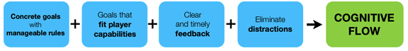
Flow states
Csikszentmihalyi also outlined four characteristics found in tasks that drive an equilibrium between skill and difficulty, thus increasing the probability of Flow states.
Increase flow states by:
Have concrete goals with manageable rules
Demand actions to achieve goals that fit within the person's capabilities
Have clear and timely feedback on performance and goal accomplishment
Diminish extraneous distraction, thus facilitating concentration
Notes:
Csikszentmihalyi also outlined four characteristics found in tasks that drive an equilibrium between skill and difficulty, thus increasing the probability of Flow states. Specifically, these are tasks that:
Have concrete goals with manageable rules.
Demand actions to achieve goals that fit within the person's capabilities.
Have clear and timely feedback on performance and goal accomplishment.
Diminish extraneous distraction, thus facilitating concentration.
It is these four task characteristics that game developers should consider if they want to increase the likelihood of causing Flow states in gamers playing their games. I will now go into more detail about each characteristic.
https://www.gamasutra.com/view/feature/166972/cognitive_flow_the_psychology_of_.php?print=1

Slide 21
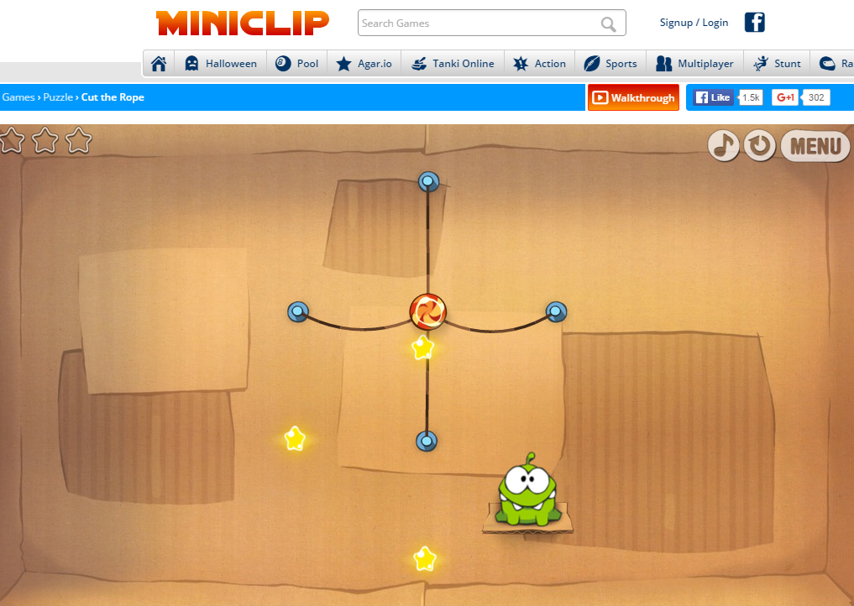
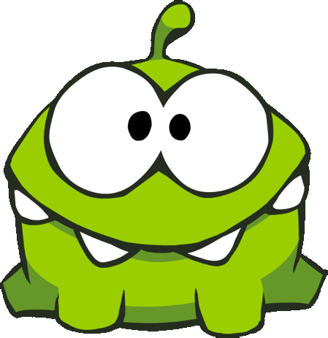
Cut the Rope / Player Experience
Go to miniclip and play cut the rope for 5 mins….

Slide 22
Cut the Rope – Post-mortem
How did the game make you feel when playing?
Does it want you to play more?
When you only got 2 out of 3 stars did you want to get more?

Slide 23
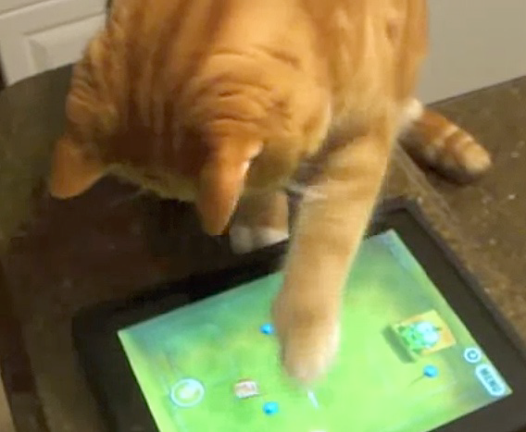
Player Experience - Goals
Makes player feel smart
Appeal both to casual
and advanced players
Keep players hungry
And wanting more

Slide 24
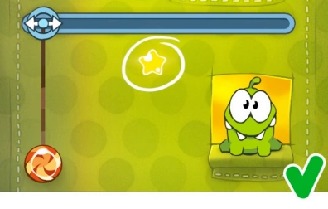

Principle in level design
1. Positive reinforcement
"Positive reinforcement is the most important and most widely applied principle of behaviour analysis"
- Cooper, Heron and Heward (2007, p.257)
2.Self managed difficulty
Hence, the game does not punish for mistakes, but gives rewards for player's effort.
This basically means that if you engage in a certain behaviour, and this behaviour gets you something that you wanted, then you are more likely to engage in that same behaviour again when you want the same outcome in the future.
Notes:
Negative reinforcement is a term described by B. F. Skinner in his theory of operant conditioning. In negative reinforcement, a response or behavior is strengthened by stopping, removing, or avoiding a negative outcome or aversive stimulus.
Aversive stimuli tend to involve some type of discomfort, either physical or psychological. Behaviors are negatively reinforced when they allow you to escape from aversive stimuli that are already present or allow you to completely avoid the aversive stimuli before they happen. Deciding to take an antacid before you indulge in a spicy meal is an example of negative reinforcement. You engage in an action in order to avoid a negative result.
One of the best ways to remember negative reinforcement is to think of it as something being subtracted from the situation.
When you look at it in this way, it may be easier to identify examples of negative reinforcement in the real-world.
Examples of Negative Reinforcement
Learn more by looking at the following examples:
Before heading out for a day at the beach, you slather on sunscreen (the behavior) to avoid getting sunburned (removal of the aversive stimulus).
You decide to clean up your mess in the kitchen (the behavior) to avoid getting into a fight with your roommate (removal of the aversive stimulus).
On Monday morning, you leave the house early (the behavior) to avoid getting stuck in traffic and being late for work (removal of an aversive stimulus).
At dinner time, a child pouts and refuses to each the vegetables on her plate. Her parents quickly take the offending veggies away. Since the behavior (pouting) led to the removal of the aversive stimulus (the veggies), this is an example of negative reinforcement.
Can you identify the negative reinforcer in each of these examples? Sunburn, a fight with your roommate and being late for work are all negative outcomes that were avoided by performing a specific behavior. By eliminating these undesirable outcomes, the preventative behaviors become more likely to occur again in the future.
https://www.khanacademy.org/test-prep/mcat/behavior/learning-slug/v/operant-conditioning-positive-and-negative-reinforcement-and-punishment

Slide 25

The skinner box Effect
Psychologists have studied the connection between choice, action, reward, and punishment in a variety of contexts. One useful approach, known as behavior theory, emphasizes observable behavior, specifically the way that interaction with an environment shapes behavior.
According to Skinner's theory of operant behavior, people learn to behave the way that they do because a certain kind of behavior has been rewarded in the past. If a lab rat learns that pressing a lever results in a food pellet appearing, it is going to develop a strong tendency to press that lever over time.
Behavior theory distinguishes between positive reinforcements (a positive reward, such as a rat getting a food pellet), negative reinforcements (the removal of something unpleasant, like silencing a loud, high-pitched noise), and punishments (the addition of something unpleasant, such as a sudden electric shock).
Operant conditioning is a method of motivation with games.
When we do something we or Brain rewards “desirable situations” dopamine!
Notes:
Conditioned Pleasure
Meaningful play is key to designing pleasure in games, but it is only by making choices that meaningful play
emerges. If you recall from Interactivity, a choice is made up of two primary components: the action that the
player takes and the outcome of that action. Our exploration of the core mechanic focused on the action half of
the equation: the actual activity that the player performs. So what about the other half-the outcome? One way
of framing this facet of the moment of choice is that whenever a player takes an action, she ends up being
rewarded or punished by the game as a result.
Psychologists have studied the connection between choice, action, reward, and punishment in a variety of
contexts. One useful approach, known as behavior theory, emphasizes observable behavior, specifically the
way that interaction with an environment shapes behavior. Ivan Pavlov and John B. Watson were early
proponents of behavior theory and developed a series of experiments designed to study learned behavior. In
one famous experiment, a bell would ring as dogs were fed a meal. Eventually, the dogs came to associate the
bell-ringing with food, and would salivate at the sound of the bell. The dogs had been "conditioned" to
provide their natural response to food (which was to salivate) even when the food was not present. Pavlov and
Watson believed that the same principles could be applied to human behavior. This kind of conditioning, in
which innate reflex responses are tied to a new stimulus, became known as classical conditioning. [16]
Psychologist B. F. Skinner refined the ideas of Watson and Pavlov by rejecting their exclusive emphasis on
reflexes and natural conditioning. Instead, Skinner attributed a more active role to the learning subject.
According to Skinner's theory of operant behavior, people learn to behave the way that they do because a
certain kind of behavior has been rewarded in the past. If a lab rat learns that pressing a lever results in a food
pellet appearing, it is going to develop a strong tendency to press that lever over time.

Slide 26
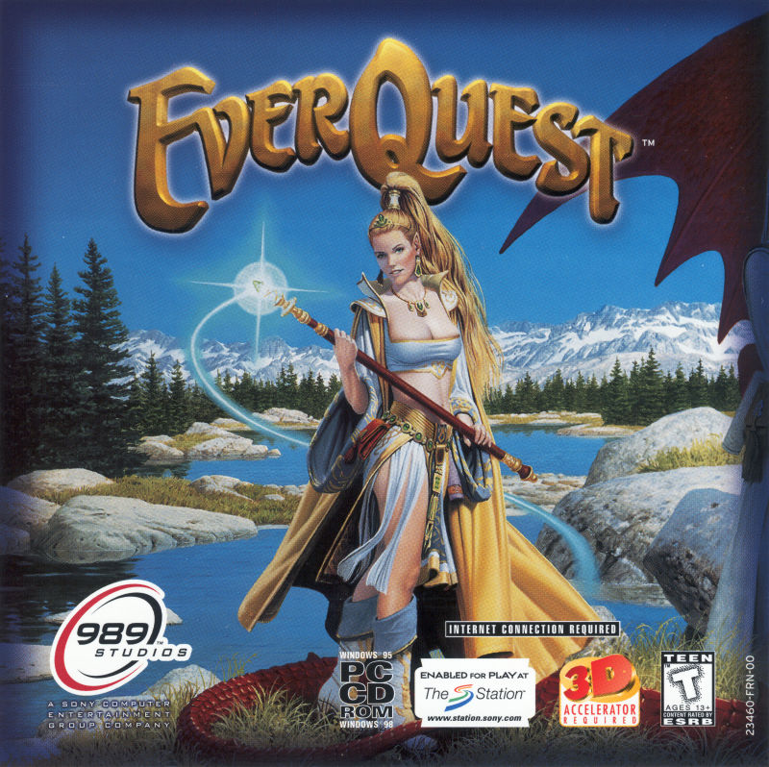
Everquest
A random ratio schedule is also the one that EverQuest uses. Both melee and trade skill points increase after a random number of attempts.
You know you won't get skill points unless you practice the skill, but you don't know how many attempts it will take to get another skill point.
Level increases also take a random number of kills. You know that you won't gain a level by standing around, but you don't know exactly how many mobs you need to kill.
Notes:
Psychologist Nick Yee has studied the reward/
punishment structure of an extremely addictive
game system, EverQuest, and he believes its addictive
power lies in a behavior theory advanced by B.F.
Skinner called “operant conditioning.” Operant conditioning
claims that the frequency of performing a given
behavior is directly linked to whether it is rewarded or
punished. If a behavior is rewarded, it is more likely to
be repeated. If it is punished, it becomes suppressed.

Slide 27

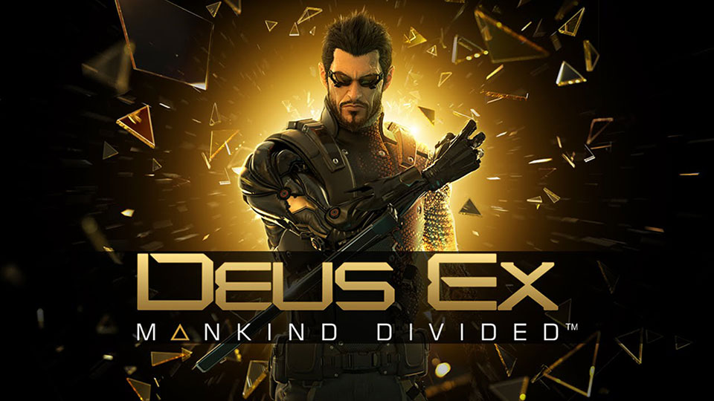
Punishment
Need to be careful with punishment as you don’t want to punished too much to stop playing your game.
Punishment can be used as to add dramatic tension in stealth games.
Balanced systems of rewards and punishments is a way of making choices in your games much more interesting.
Notes:
Think of a game that forces the player to be
stealthy, like Thief or Deus Ex. The tension, when you
are trying to accomplish a task without being caught,
is tremendous. Getting caught and attacked—and let’s
face it: killed—is not fun. But that moment when you
oh, so quietly pick a lock and sneak past the security
bots without incurring any harm is made much more
effective by the threat that the anvil of punishment was
hanging over your head all the time (see Figure 11.11).
Coming up with a balanced system of rewards
and punishments is a way of making the choices in
your games much more interesting for players. The
type of rewards you offer can vary, but the best
rewards are those that have utility or value in the
game.

Slide 28
Choices / decisions / dilemmas
Barry Schwartz described the Paradox of Choice (Schwartz, 2004). After extensive study, he concluded that while having some choice is good, having too many choices can be severely detrimental.
option paralysis - It can also happen whether the decisions are trivial, like picking a type of jelly, or a major life event, like buying a house. In a nutshell, having too many options makes the task seem more difficult and breaks flow.
When our brain struggles with too much data, it looks for ways to make the decision easier. That’s good right but then the bad side is that we are likely to discard criteria that we may have otherwise considered extremely important. The result is that people make worse decisions.
Who has ever made a decision and you find that whatever option they pick and will feel worse. Because there are too many choices, people cannot balance all of the factors, so they simplify.
Notes:
Barry Schwartz described the Paradox of Choice (Schwartz, 2004). After extensive study, he concluded that while having some choice is good, having too many choices can be severely detrimental. The first thing he found is that people facing too many options often suffer from option paralysis. This is where people become incapable of making a decision and so chose nothing. This can happen even if all the options have positive outcomes. It can also happen whether the decisions are trivial, like picking a type of jelly, or a major life event, like buying a house. In a nutshell, having too many options makes the task seem more difficult and breaks flow. Unfortunately, that is not the only problem created by choice. Schwartz also found that people seem to be hard-wired to simplify the decision criteria when faced with too many options. In other words, humans begin to group options into simple categories – in whatever way makes sense at the time. When our brain struggles with too much data, it looks for ways to make the decision easier. The good side is that it makes it possible for us to decide. The bad side is that we are likely to discard criteria that we may have otherwise considered extremely important. The result is that people make worse decisions. In some cases, Schwartz found that the criteria can become so simplified that it essentially becomes a random choice. The simplified criteria also make it harder to correlate cause and effect, which makes the task seem more difficult and disrupts flow. Finally, Schwartz found that people will be less happy with whatever option they pick and will feel worse. Because there are too many choices, people cannot balance all of the factors, so they simplify. They know something important is being lost in the process and instinctively conclude that whatever they pick is probably not the best choice. This leads to increased regret about the decision they make, whether right or wrong. It also causes anticipation of regret, which is a regret we feel before we even make a decision. Both feelings of regret are distractions that disrupt flow. This has huge implications for game design. Fortunately, the solutions are pretty straight forward.
1. Remember the age-old axiom, less is more. Since “everything suffers from comparison” (Schwartz, 2006, p. 181), present less things to compare.
2. Sometimes learning games need to teach or test subtle differences in the material, but they shouldn’t do it all at once. Break things up.
3. When forcing players to make decisions, limit the number of options and keep them simple.
4. When designing game mechanics, minimize the number of distinct actions a player can take at any one time. Design your interfaces with the minimal number of options required to meet the learning goals. A good rule of thumb is four.
5. Finally, provide a default when you can. That means showing a default for the choice - something that is in their best interest. The default makes it okay to forgo a decision while still getting a positive outcome. This technique is simple and very effective. When players aren’t sure what to pick, the default makes the choice much simpler, reduces the feelings of regret, and minimizes distractions.
Examples of how this works in games are easy to find. Consider that Tiny Wings™ has only one choice – touch the screen now or not. Consider that players in League of Legends™ have only four primary abilities that player’s can use for any champion. Consider that in World of Warcraft™, there were originally only nine classes to pick from, where major competitors at the time had 24 or more. Each of these is a wildly successful game where the design benefitted from fewer, more meaningful decisions that led to better flow.

Slide 29
Choices / decisions / dilemmas
This has huge implications for game design.
Fortunately, the solutions are pretty straight forward.
1. Remember the age-old axiom, less is more. Since “everything suffers from comparison” (Schwartz, 2006, p. 181), present less things to compare.
2. Sometimes learning games need to teach or test subtle differences in the material, but they shouldn’t do it all at once. Break things up.
3. When forcing players to make decisions, limit the number of options and keep them simple.
4. When designing game mechanics, minimize the number of distinct actions a player can take at any one time. Design your interfaces with the minimal number of options required to meet the learning goals. A good rule of thumb is four.
5. Finally, provide a default when you can. That means showing a default for the choice - something that is in their best interest. The default makes it okay to forgo a decision while still getting a positive outcome. This technique is simple and very effective. When players aren’t sure what to pick, the default makes the choice much simpler, reduces the feelings of regret, and minimizes distractions

Slide 30
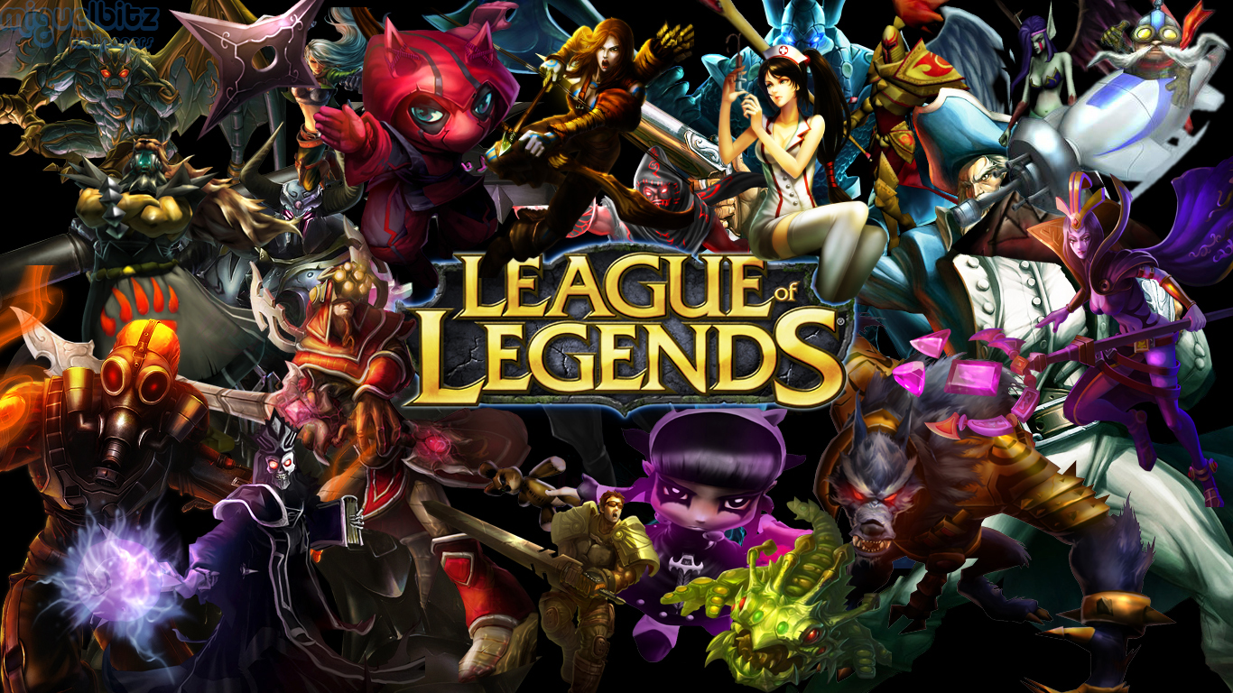
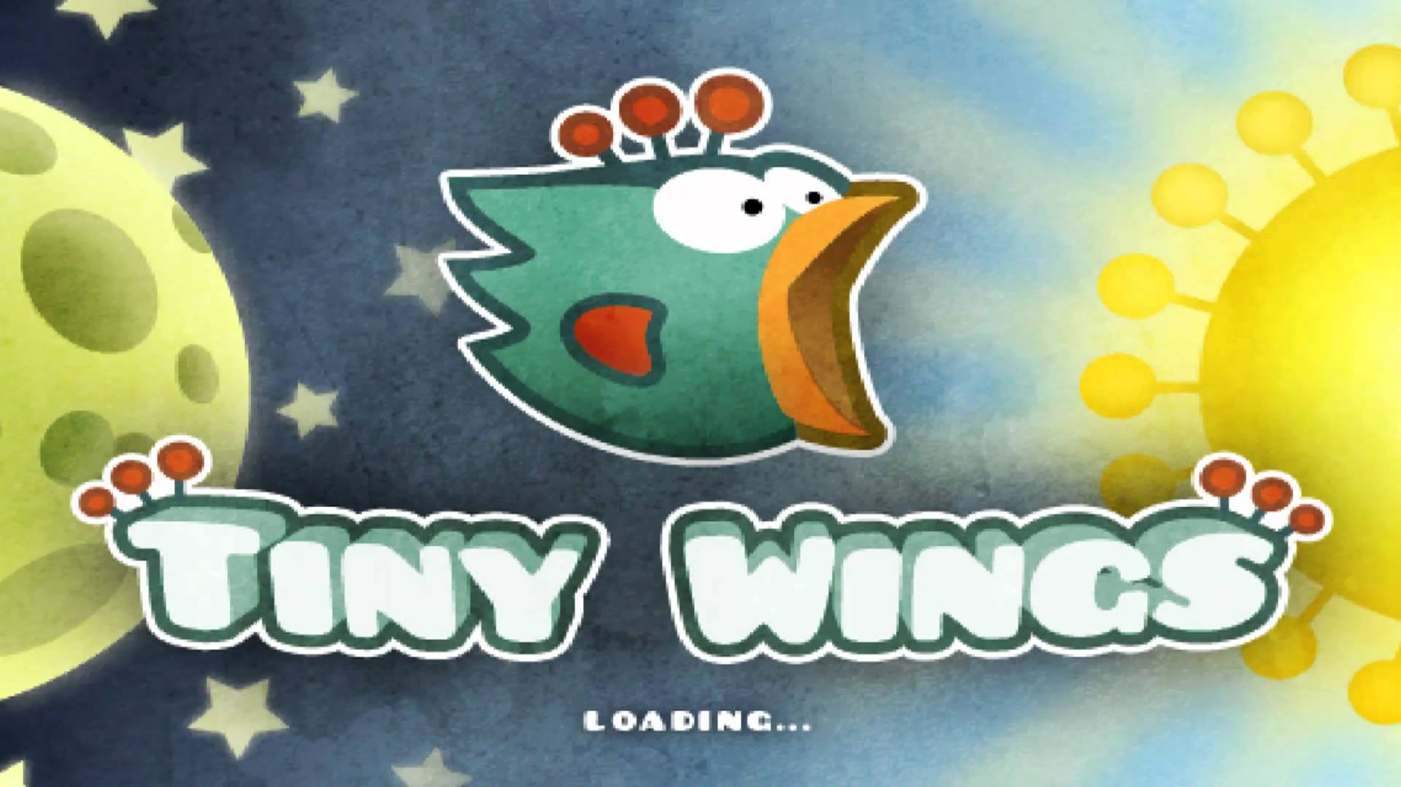
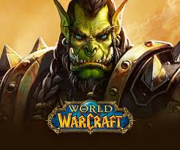
Choices / decisions / dilemmas
Only four primary abilities that player’s can use for any champion.
Only one choice – touch the screen now or not.
Only nine classes to pick from, where major competitors at the time had 24 or more.
Where the design benefitted from fewer, more meaningful decisions that led to better flow.
Notes:
Barry Schwartz described the Paradox of Choice (Schwartz, 2004). After extensive study, he concluded that while having some choice is good, having too many choices can be severely detrimental. The first thing he found is that people facing too many options often suffer from option paralysis. This is where people become incapable of making a decision and so chose nothing. This can happen even if all the options have positive outcomes. It can also happen whether the decisions are trivial, like picking a type of jelly, or a major life event, like buying a house. In a nutshell, having too many options makes the task seem more difficult and breaks flow. Unfortunately, that is not the only problem created by choice. Schwartz also found that people seem to be hard-wired to simplify the decision criteria when faced with too many options. In other words, humans begin to group options into simple categories – in whatever way makes sense at the time. When our brain struggles with too much data, it looks for ways to make the decision easier. The good side is that it makes it possible for us to decide. The bad side is that we are likely to discard criteria that we may have otherwise considered extremely important. The result is that people make worse decisions. In some cases, Schwartz found that the criteria can become so simplified that it essentially becomes a random choice. The simplified criteria also make it harder to correlate cause and effect, which makes the task seem more difficult and disrupts flow. Finally, Schwartz found that people will be less happy with whatever option they pick and will feel worse. Because there are too many choices, people cannot balance all of the factors, so they simplify. They know something important is being lost in the process and instinctively conclude that whatever they pick is probably not the best choice. This leads to increased regret about the decision they make, whether right or wrong. It also causes anticipation of regret, which is a regret we feel before we even make a decision. Both feelings of regret are distractions that disrupt flow. This has huge implications for game design. Fortunately, the solutions are pretty straight forward. 1. Remember the age-old axiom, less is more. Since “everything suffers from comparison” (Schwartz, 2006, p. 181), present less things to compare. 2. Sometimes learning games need to teach or test subtle differences in the material, but they shouldn’t do it all at once. Break things up. 3. When forcing players to make decisions, limit the number of options and keep them simple. 4. When designing game mechanics, minimize the number of distinct actions a player can take at any one time. Design your interfaces with the minimal number of options required to meet the learning goals. A good rule of thumb is four. 5. Finally, provide a default when you can. That means showing a default for the choice - something that is in their best interest. The default makes it okay to forgo a decision while still getting a positive outcome. This technique is simple and very effective. When players aren’t sure what to pick, the default makes the choice much simpler, reduces the feelings of regret, and minimizes distractions. Examples of how this works in games are easy to find. Consider that Tiny Wings™ has only one choice – touch the screen now or not. Consider that players in League of Legends™ have only four primary abilities that player’s can use for any champion. Consider that in World of Warcraft™, there were originally only nine classes to pick from, where major competitors at the time had 24 or more. Each of these is a wildly successful game where the design benefitted from fewer, more meaningful decisions that led to better flow.

Slide 31
repetition
Repetition is another technique used to balance difficulty.
In a learning game, you need to design repetition so that players get the information they need to improve their performance with each iteration. But, these tasks must also be designed so that players want to repeat the actions to improve their skills, and ultimately, remain in flow.
Allow players to fail and give them appropriate feedback, so they can repeat the sequence and improve their play.
The play should be engaging and balanced, so that players will want to repeat the task until they get it right. The following design guidelines can help keep the player in flow and engaged with the learning activity.
The correlation between repetition and learning has been well studied (Greene 2009, Hintzman et al,. 1995, Miller et al. 2004).
Notes:
Design and Development of Training Games: Practical Guidelines from a ...

Slide 32
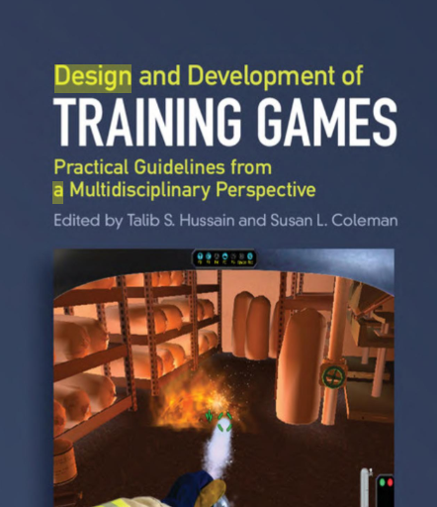
Repetition Guidelines
Design small consequences for failure on necessary, but minor tasks. Most games simply let players try again.
Give the player enough feedback so they can figure out how to improve their performance the next time. Hints, keep the activity challenging, but still accomplishable.
Minimize the use of instant death mechanics. That is, situations where a single mistake results in complete failure. For instance, jumping off of a cliff. While these lessons are important, too much instant death makes a game feel difficult and unforgiving.
Avoid long recoveries after failure that creates boredom and disrupts flow. Have partial-recovery points. Try to break missions/chapters into smaller, bite-sized pieces.
Allow players to skip excessive and meaningless repetition of the same skill. Focus on skills related to the learning objectives, let the player know when they succeeded, and move on.
Make the repeated task feel different each time around. This means providing choices, actions, and control so that the player can become engaged in a similar but slightly different experience.
Avoid repetition without learning. Entertainment games sometimes use repetition to extend hours of play, which is not the goal of learning games. The classic example is the inability to describe the details of a Penny
Notes:
Design small consequences for failure on necessary, but minor tasks. Most games simply let players try again. Games commonly use this technique to ensure that players have adequately learned necessary skills before progressing to the next level of difficulty, without discouraging them. In essence, “failure is part of the process that leads to success” (Beck and Wade, 2004, p. 134).
Give the player enough feedback so they can figure out how to improve their performance the next time. You don’t have to give them the answers, just enough hints to point them in the right direction and keep the activity challenging, but still accomplishable.
Minimize the use of instant death mechanics. That is, situations where a single mistake results in complete failure. In both entertainment and learning games, we use instant death mechanics to drive home that certain actions should always be avoided. For instance, jumping off of a cliff or causing fellow ship-mates to die. While these lessons are important, too much instant death makes a game feel difficult and unforgiving.
Avoid long recoveries after failure. This typically happens in lengthy missions/chapters that don’t have partial-recovery points. This leads to long repeats of the easy content that creates boredom and disrupts flow. Try to break missions/chapters into smaller, bite-sized pieces or allow players to re-enter the level at different points.
Allow players to skip excessive and meaningless repetition of the same skill. Focus on skills related to the learning objectives, let the player know when they succeeded, and move on.
Make the repeated task feel different each time around. This means providing choices, actions, and control so that the player can become engaged in a similar but slightly different experience. Alternately, the next time around, the process should go much faster. This allows them to enjoy the experience of mastery over previously challenging content.
Avoid repetition without learning. Entertainment games sometimes use repetition to extend hours of play, which is not the goal of learning games. The classic example is the inability to describe the details of a penny (Hintzman et al., 1995). We see thousands of pennies in our lives, but we never learn much about it, nor do we care. That is repetition without learning.

Slide 33

Reflection
Reflection includes both thinking about and communicating with others about the performance. The tricky part with reflection is not whether it works, but rather, how to create moments of reflection in a game without creating huge breaks in game play.
Clever use of reflection can help players think about their mistakes and allow them to improve their skills and overcome a previously unsolvable problem
One of the most common moments of reflection in games is the score screen, or in military jargon, the debrief.

Slide 34
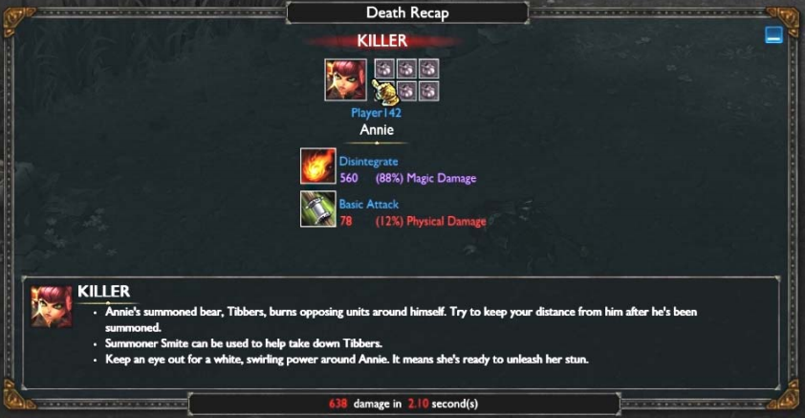
Reflection
Here, the player has been slain by opponents and must wait 30-60 seconds before respawning and getting back into the action. This cooling off period affords an opportunity for reflection.
After they respawn, the players can apply what they have learned by purchasing defensive items or changing tactics with their team.
League of Legends™

Slide 35
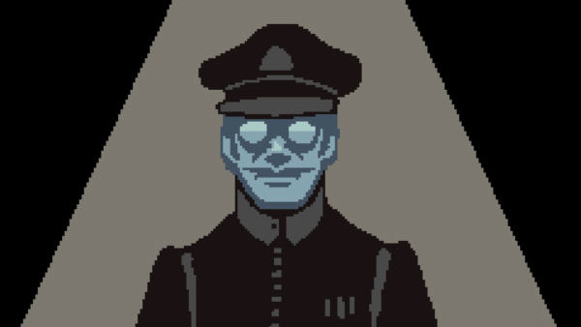


Engagement and Motivation
Papers please
A technique commonly used to increase motivation and engagement is the use of emotional pulls. Emotional pulls are effective because we are emotional beings by nature.
When using emotional motivation, always consider the target audience and the domain. For example, the crew of a ship may be particularly sensitive to the dangers of dying at sea; and budding surgeons may be particularly motivated by losing a patient.
Damage Control Trainer, a critical error can lead to a video showing the death of shipmates as seen in Figure 3.1. In this case, the emotional experience provides both feedback and motivation that leads to increased engagement and flow.
firewatch
Notes:
https://www.theguardian.com/technology/2016/feb/08/firewatch-review-first-person-simulation-adventure-game

Slide 36
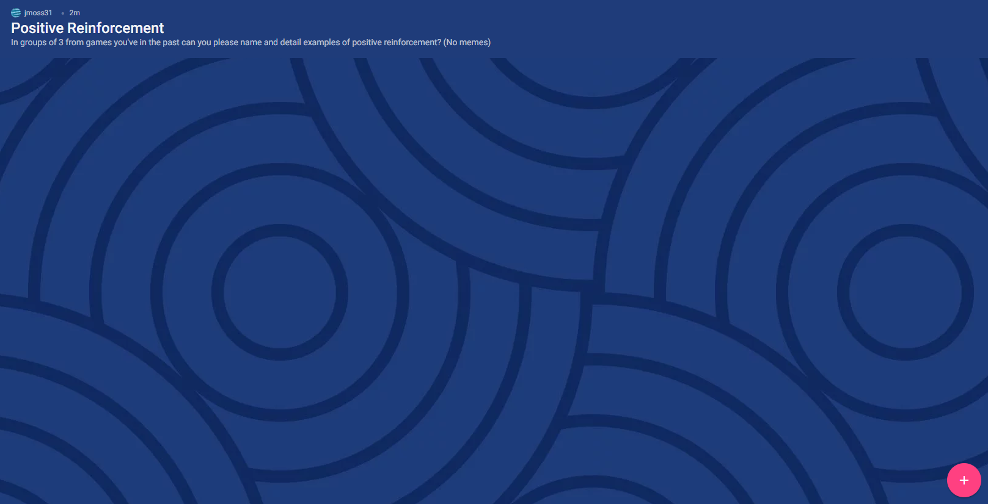
practical
In groups of 3 from games you’ve played in the past can you please name and detail examples of positive reinforcement used within games?

